Slide 1
The (n, k)-star graph:
A generalized star graph
Wei-Kuo Chiang, Rong-Jaye Chen
Information Processing Letters 56 ( 1995) 259-264
Presenter: Chiao-Wei Chiu (邱喬偉)
Date: Aug. 22, 2007

Slide 2
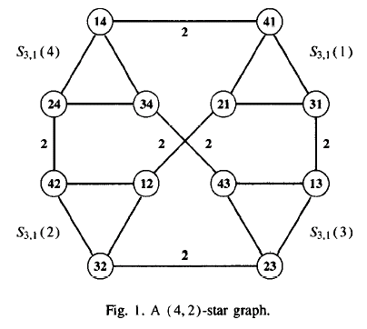
The (n, k)-star graph

Slide 3
Node symmetric
The (n, k) -star graph is node symmetric.
Note that S_{n,k} could not be edge symmetric.

Slide 4
Fault tolerance
Definition
The fault tolerance of a graph G is defined as the maximum number f such that if any f nodes are deleted from G, the resulting subgraph is still connected.
Theorem
The fault tolerance of the (n, k)-star graph is n - 2.

Slide 5
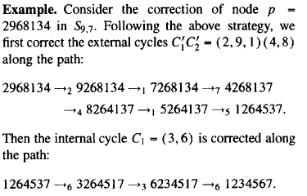

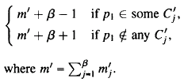
Permutation cycle
node p = 2968134
destination I_{k} = 1234567
internal symbol : 1, 2, 3, 4, 6
external symbol : 8, 9
internal cycle: C₁ = (3, 6)
external cycle: C’₁ C’₂ = (1, 2, 9)(4, 8)
steps required to correct each
internal cycle C_{i} of length m_{i}
steps required to correct the β external cycles

Slide 6

Distance
Definition
The distance between two nodes in G is the length of a shortest path joining them.
Theorem
The distance d(p) from a node p to the identity node I_{k} in S_{n,k} is given by
c = α (number of internal cycles) if β= 0
c = α+1 if β> 0
m = number of misplaced symbols
e = β (number of external symbols)

Slide 7





Proof.
  if p₁ = 1
    if β> 0
  if p₁ != 1
    if β> 0 and
    if β> 0 and

Slide 8
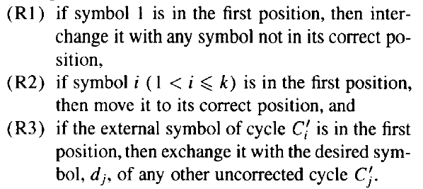
Routing

Slide 9
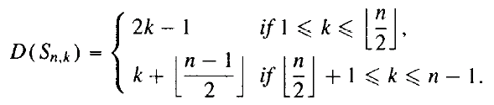
Diameter
Definition
The diameter of G is the largest distance between nodes of G.
Theorem
The diameter D(S_{n,k}) of S_{n,k} is given by

Slide 10


e.g. S_{9,4}
  if p₁ = 1 1789 c = 1, m = k - 1, e = k - 1
  if p₁ != 1 6789 c = 1, m = k , e = k
e.g. S_{9,5}
  if p₁ = 1 16789 c = (2k - n -1)/2 + 1, m = k-1, e = n – k
  if p₁ != 1 56789 c = (2k - n)/2 + 1, m = k, e = n - k

